Slide 1
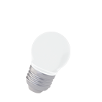
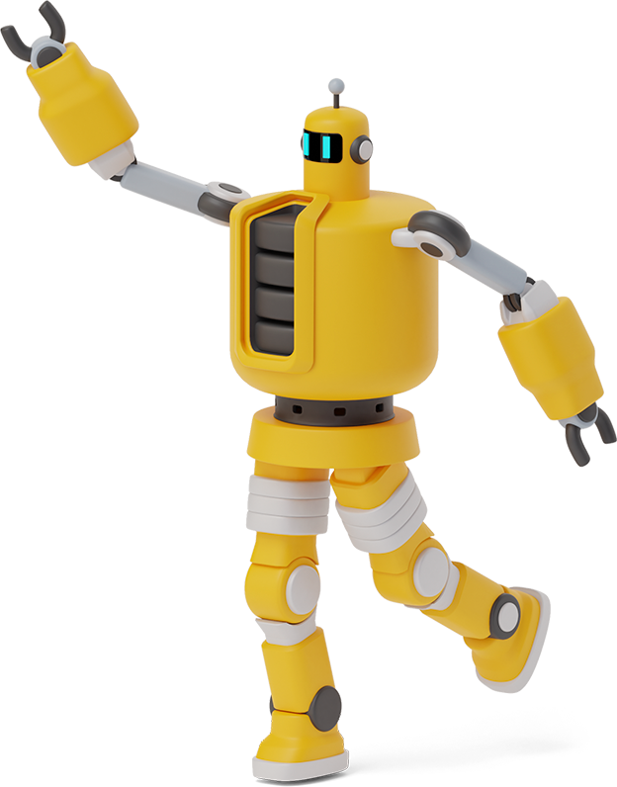
Python Playground

Slide 2
Roadmap
Homework Takeup
Input Function Cont’d.
Intro to Functions
1
3
5
2
4
6
Review of Past Class
Class Activity
Class Activity

Slide 3
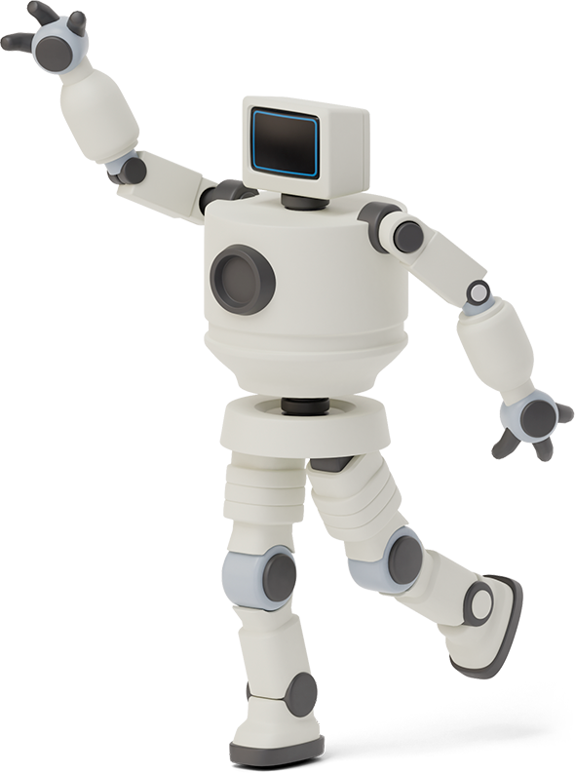

Homework Link
https://github.com/Asfandyar-Khan/PythonPlayground/blob/main/index.md
Contains all lectures and Google Colab notebooks
Contains homework which will be a word document
Does anyone have any homework questions?

Slide 4
Review of Last Week
Expressions vs. Statements
What is a variable?
How do we use variables?
String formatting (Using .format)
Input function

Slide 5
Let’s Review the Input Function!

Slide 6
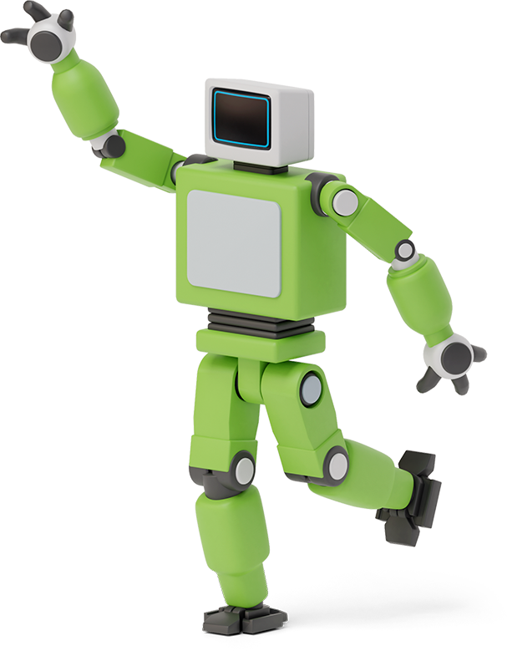


Input Function
Input()
This function allows us to take input from a user and store it in a variable!
Syntax:
input_variable = input(argument 1)

Slide 7
Input Function, continued
name = input('Enter your name =')
age = input('Enter your age = ')
print('Your name is ', name )
print('Your age is ', age )
Can we do this on one line instead of two?

Slide 8

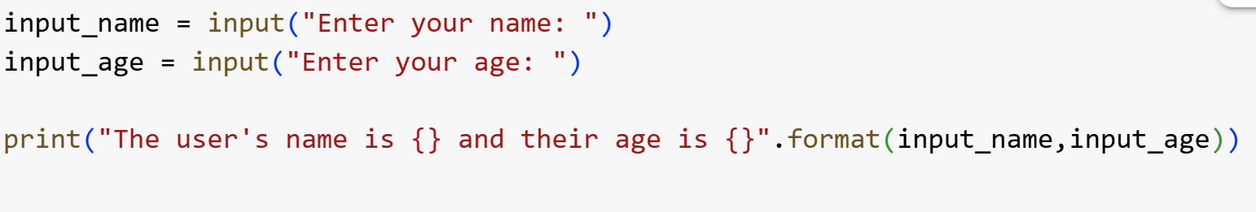
Last Week’s Class Activity
Create a python program using the input() function that asks users for their name, their age, and how many pets they have
Print out these results on a single line of code if you can

Slide 9
Class Activity
Use the input function to create 3 variables
Name
Apples
Bananas
Create a new variable called total_fruit that adds the user’s apples and bananas together
On one line print the following message:
“Bob has 5 apples and 10 bananas and a total of 15 pieces of fruit!”

Slide 10
What is a Function?
A function is a set of statements that run when the function is called
Python has many built in functions!
print(), type(), int(), float(), str(), round()
What if we want to build our own functions?

Slide 11
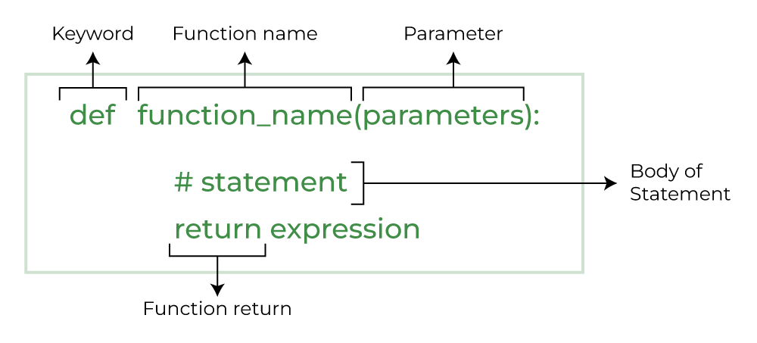
What is a Function?

Slide 12
Function Example
Write a function that outputs a few of the
introductory sentences we covered in
past classes
def favourite_sentences():
print(“My name is Bob”)
print(“My age is 10”)
Does anyone want to guess what this function will do?

Slide 13
Function Example 2
def print_twice(string):
print(string)
print(string)
Notice how string is now added as a parameter
How does this function work?
What will happen if you call this function?
Can this function be called without any input?

Slide 14

For Loops
A for loop iterates over a sequence – such as a string, list, or tuple
Allows you to run a block of code repeatedly
This occurs once for each item in the sequence
Syntax:
for item in iterable:
# Code to be executed for each item

Slide 15

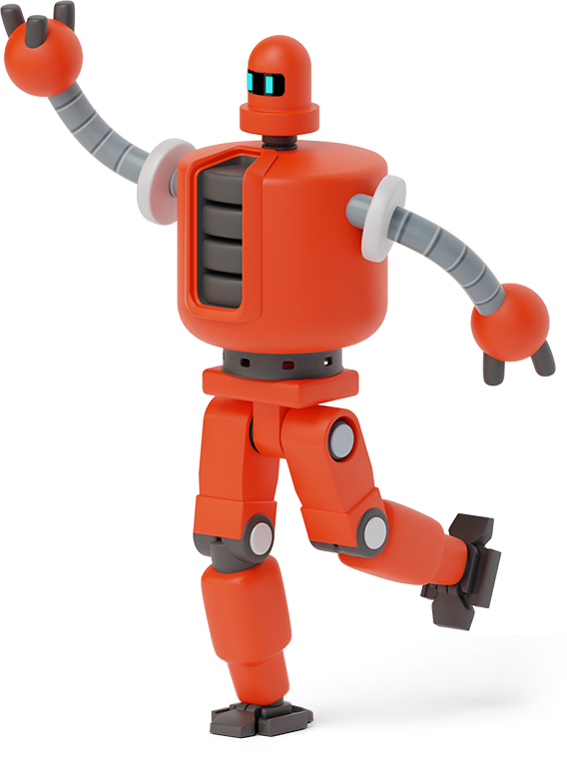
Class Activity
Create a function that prints out your favourite food!
Everytime this function is called, your favourite food is going to be printed as text in the Python editor

Slide 16
Thanks!
Any questions?

